Slide 1

Update on Fast TDA Project
Charlton Rolle

Slide 2
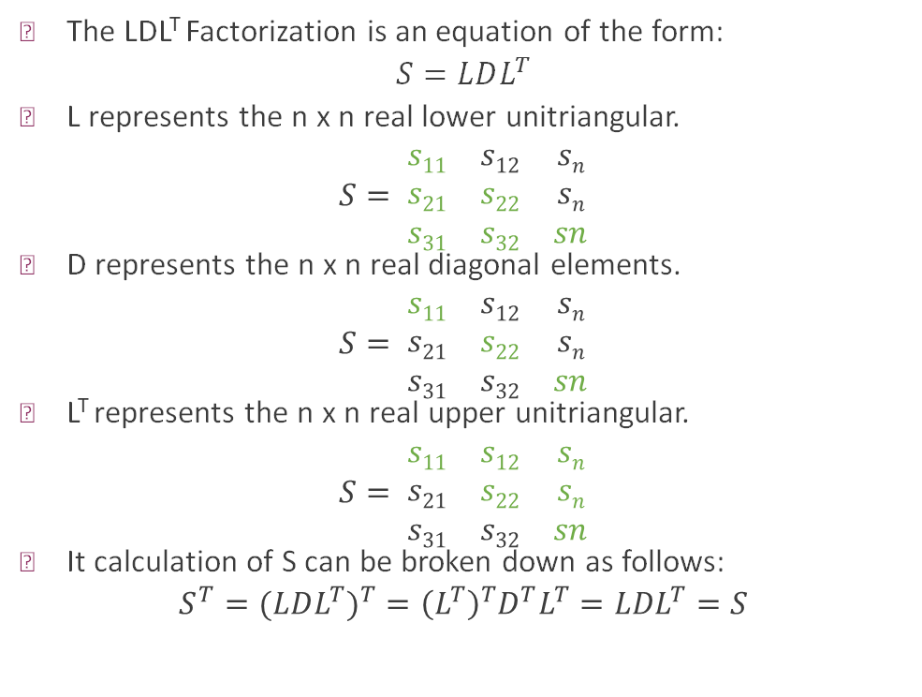
LDL^{T} Factorization
The LDL^{T} Factorization is an equation of the form:
$$S=LDL^{T}$$
L represents the n x n real lower unitriangular.
$$S= \begin{matrix}s11 & s12 & sn \\ s21 & s22 & sn \\ s31 & s32 & sn\end{matrix}$$
D represents the n x n real diagonal elements.
$$S= \begin{matrix}s11 & s12 & sn \\ s21 & s22 & sn \\ s31 & s32 & sn\end{matrix}$$
L^{T} represents the n x n real upper unitriangular.
$$S= \begin{matrix}s11 & s12 & sn \\ s21 & s22 & sn \\ s31 & s32 & sn\end{matrix}$$
It calculation of S can be broken down as follows:
$$S^{T}=(LD{L^{T})}^{T}={\left(L^{T}\right)}^{T}D^{T}L^{T}={LDL}^{T}=S$$

Slide 3
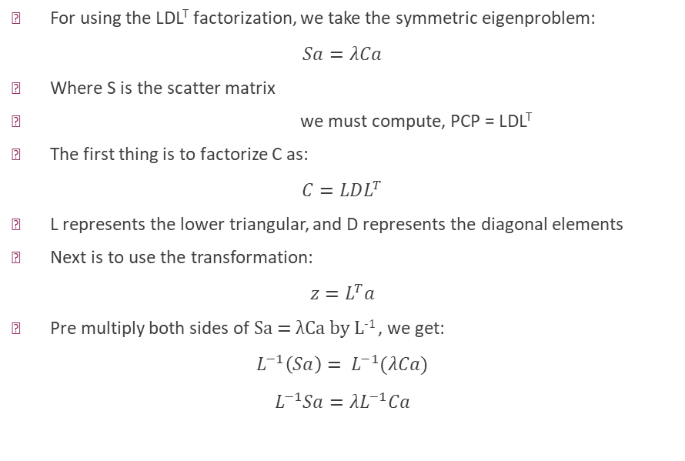
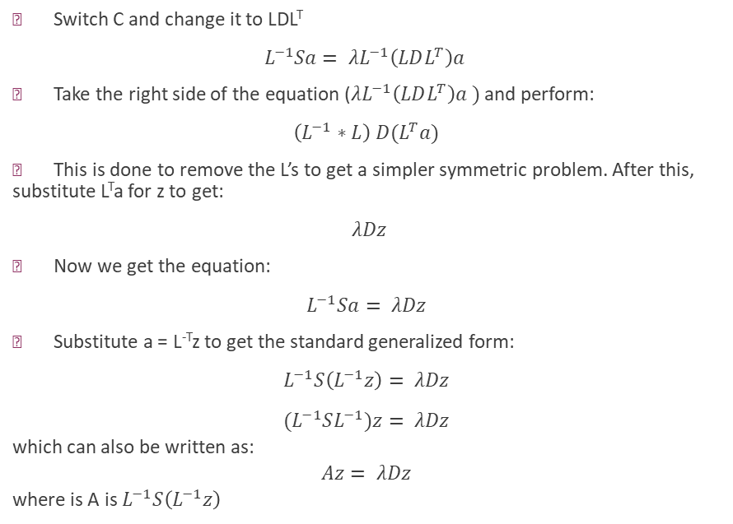
LDL^{T} Factorization
For using the LDL^{T} factorization, we take the symmetric eigenproblem:
$$Sa=λCa$$
Where S is the scatter matrix
we must compute, PCP = LDL^{T}
The first thing is to factorize C as:
$$C=LDL^{T}$$
L represents the lower triangular, and D represents the diagonal elements
Next is to use the transformation:
$$z=L^{T}a$$
Pre multiply both sides of Sa = λCa by L⁻¹ , we get:
$$L^{−1}\left(Sa\right)= L^{−1}(λCa)$$
$$L^{−1}Sa={λL}^{−1}Ca$$
Switch C and change it to LDL^{T}
$$L^{−1}Sa= λL^{−1}\left(LDL^{T}\right)a$$
Take the right side of the equation ($λL^{−1}\left(LDL^{T}\right)a )$ and perform:
$$\left(L^{−1}∗L\right) D(L^{T}a)$$
This is done to remove the L’s to get a simpler symmetric problem. After this, substitute L^{T}a for z to get:
$$λDz$$
Now we get the equation:
$$L^{−1}Sa= λDz$$
Substitute a = L^{-T}z to get the standard generalized form:
$$L^{−1}S\left(L^{−1}z\right)= λDz$$
$${(L}^{−1}SL^{−1})z= λDz$$ which can also be written as: $$Az= λDz$$ where is A is $L^{−1}S\left(L^{−1}z\right)$

Slide 4

LDL^{T} Factorization
Next is to normalize by pre-multiplying by D^{-1/2}
$${(D}^{{−1}/2}y)Az= D^{{−1}/2}y(λD)$$
We then define y = D^{1/2}z and rescale it to z = D^{-1/2}y so D becomes the identify matrix. Then simplify the right side so it becomes:
$$\left(D∗ D^{{−1}/2}\right)λz$$ which becomes:
$$λD^{1/2}y$$
where we get:
${(D}^{{−1}/2})A {(D}^{{−1}/2})y= D^{1/2}(λD)D^{{−1}/2}$y
Then this is done, essentially we remove the D element to make it more standardize and get:
${(D}^{{−1}/2})A {(D}^{{−1}/2}y)=λy$
$$A′y= λy$$

Slide 5
References
Generalized Symmetric Definite Eigenproblems
https://youtu.be/i7iAd0p6t9I?si=KTZI0DxkAIb0FofO
week11.pdf

